Slide 1

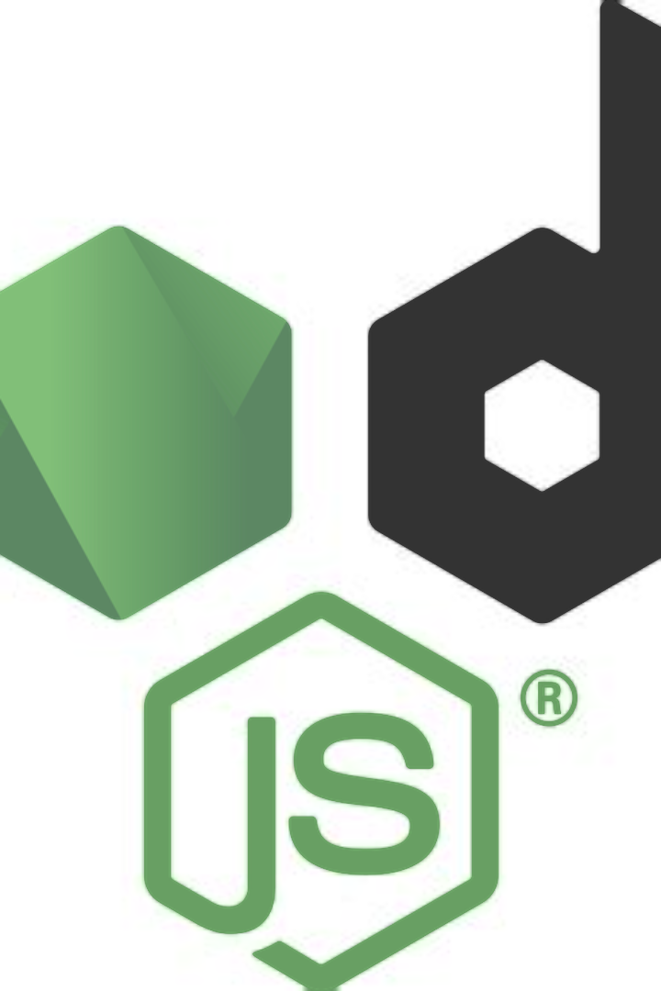
What is Node.js?
Node.js is an open-source, cross-platform JavaScript runtime environment that executes JavaScript code outside of a web browser. It allows developers to use JavaScript for server-side scripting, producing dynamic web page content before the page is sent to the user's web browser. Node.js provides a rich library of various JavaScript modules which greatly simplifies the development of web applications.

Slide 2
Features of Node.js
Asynchronous and Event-Driven
Scalable
Single Programming Language
It is designed to handle asynchronous I/O from a large number of simultaneous connections, making it highly scalable for network applications.
Node.js uses non-blocking, event-driven architecture that makes it lightweight and efficient, ideal for real-time web applications.
With Node.js, developers can use JavaScript to write both the client-side and server-side parts of an application, reducing the language barrier.

Slide 3
Benefits of using Node.js
1
Efficiency
2
Open Source Community
Node.js provides a non-blocking, event-driven architecture which makes it extremely efficient.
Node.js has a vibrant community that contributes to its growth, creating an extensive library of modules and extensions.
3
Performance
4
Scalability
It offers high performance due to its event-driven, non-blocking I/O model.
Node.js is designed to handle large-scale, real-time applications with ease.

Slide 4
Managing Packages with NPM
NPM is an acronym for Node.js Package Manager
NPM provides a public package repository, a specification for building packages, and a command line tool for working with packages
http://www.npmjs.com
The company npm, Inc. develops and maintains NPM
Node.js distributes the npm executable along with the node executable, but it's actually a separate program with its own versioning
A package contains all the files needed for a module and modules are the JavaScript libraries that can be included in Node project according to the requirement of the project.
The top npm packages in the decreasing order are: lodash, async, react, request, express

Slide 5
Node Package Manager (NPM)
1M
10K
Packages
Weekly Downloads
NPM hosts over 1 million packages of reusable code, making it the largest software registry in the world.
Popular packages on NPM may receive tens of thousands of downloads each week, showing the platform's widespread use.

Slide 6
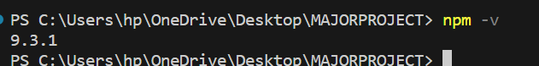
Installing NPM
To install NPM, it is required to install Node.js as NPM gets installed with Node.js automatically.
Checking and updating npm version:
Version of npm installed on system can be checked using following syntax:
Syntax:
npm -v :
updating npm version:
Version of npm installed on system can be updated using following syntax:
Syntax:
npm update npm@latest -g.

Slide 7
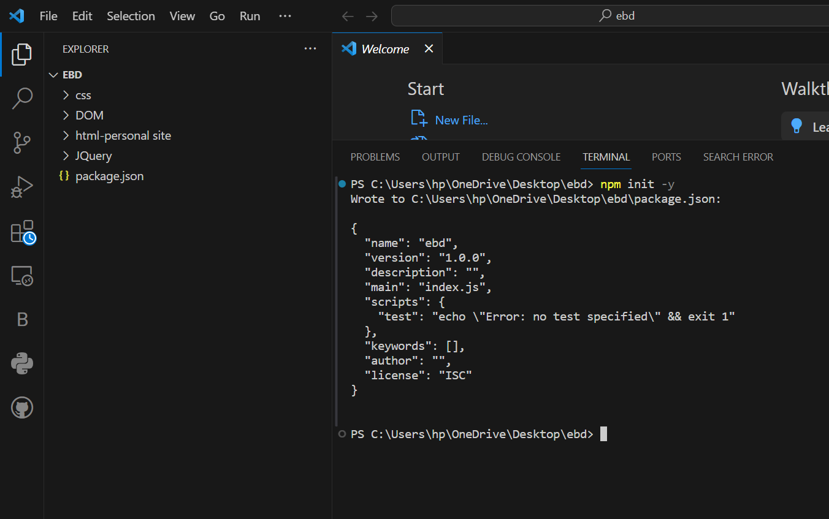
Creating a Node Project:
To create a Node project, npm init is used in the folder in which user want to create project. The npm command line will ask a number of questions like name, license, scripts, description, author, keywords, version, main file etc. After npm is done creating the project, a package.json file will be visible in project folder as a proof that the project has been initialized.

Slide 8
Installing & Uninstalling Packages
The npm program is used to manage packages
The first argument to the npm program is the command to be executed
Packages can be installed with the install command, and uninstalled with the uninstall command
There are many more commands available for NPM
npm install package_name
npm install express
var express = require('express');
The –global flag installs and uninstalls the package globally, without the global flag, the packages are installed and uninstalled locally
npm install nodemon -g

Slide 9
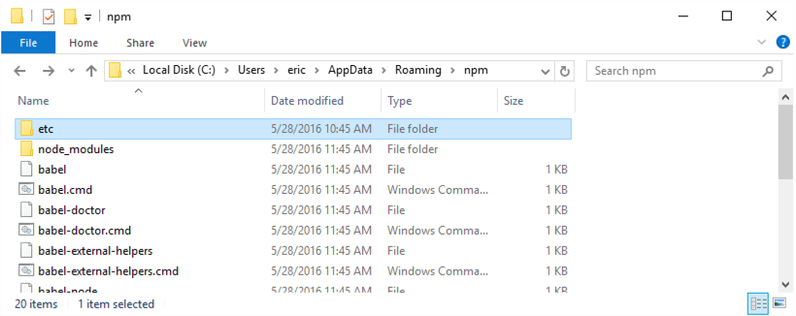
Global Packages on Windows
Are global to the user, not the system
Does not require administrative privileges
Globally Installed Packages are stored in:
C:\Users\<username>\AppData\Roaming\npm

Slide 10
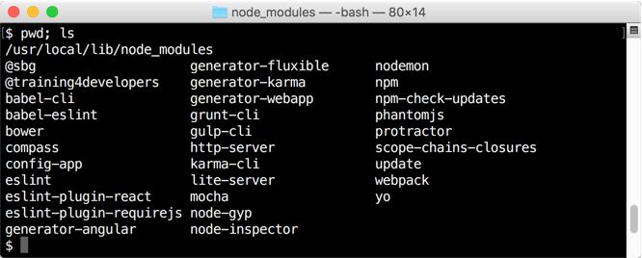
Global Packages on Mac and Linux
By default, are global to the system, not just the user
Requires administrative privileges, unless permissions are fixed
On a Mac by default, Globally Installed Packages are stored in:
/usr/local/lib/node_modules

Slide 11
Building a Simple Web Server
One of the core modules for Node.js is the HTTP module, which provides a web server and web client
The web server is very flexible, but requires a lot of boiler plate coding to build even the simplest applications
Commonly, other packages such as Express or Hapi are used to configure the web server
Web server are I/O intensive applications making them well suited for Node.js
Node.js is great for web servers because of its easy handling of JSON data

Slide 12
const http = require('http');
// Create a server
http.createServer((request, response) => {
// Sends a chunk of the response body
response.write('Hello World!');
// Signals the server that all of
// the response headers and body
// have been sent
response.end();
}).listen(3000); // Server listening on port 3000
console.log("Server started on port 3000");

Slide 13
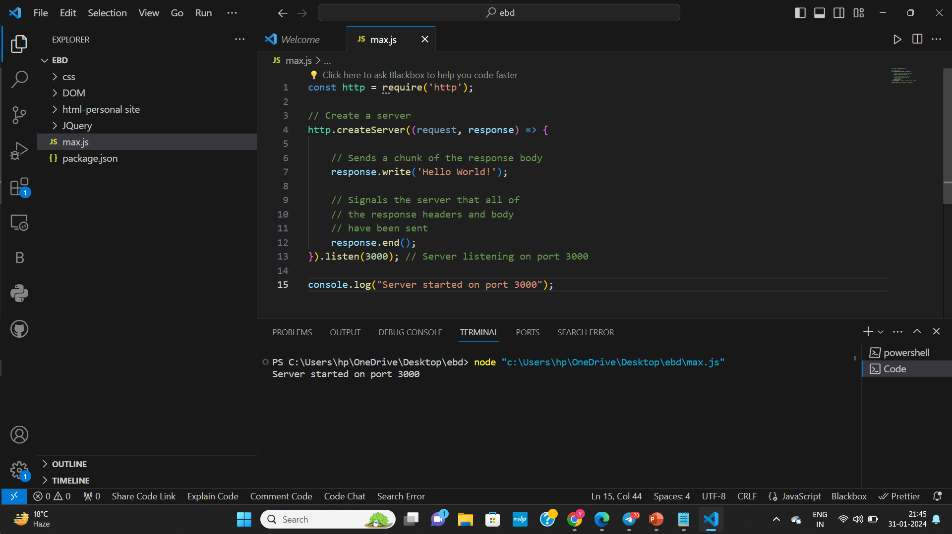

Slide 14
Node.js is an open source server-side Javascript run-time environment built on Chrome’s JavaScript Engine(V8). Node.js is used for building fast and scalable applications and is an event driven, non-blocking I/O model.
REPL (READ, EVAL, PRINT, LOOP) is a computer environment similar to Shell (Unix/Linux) and command prompt.
Read : It reads the inputs from users and parses it into JavaScript data structure. It is then stored to memory.
Eval : The parsed JavaScript data structure is evaluated for the results.
Print : The result is printed after the evaluation.
Loop : Loops the input command. To come out of NODE REPL, press ctrl+c twice

Slide 15
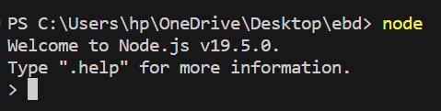
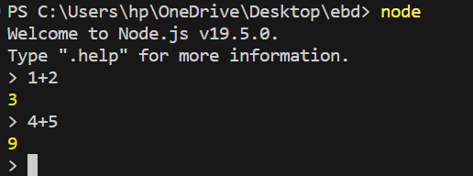
Getting Started with REPL:
To start working with REPL environment of NODE; open up the terminal (in case of UNIX/LINUX) or the Command prompt (in case of Windows) and write node and press ‘enter’ to start the REPL.

Slide 16
Reading Files from Disk
Node.js allows full access to the system (such as accessing the file system), unlike a web browser which only allows sandboxed access
Accessing file system resources can be synchronously and asynchronously
Synchronous access can be used for initial program loading, but only asynchronous access should be used during program operation
Both text and binary data can read and written
Full support for streams

Slide 17
The path.join() method is used to join a number of path-segments using the platform-specific delimiter to form a single path. The final path is normalized after the joining takes place. The path-segments are specified using comma-separated values.
Syntax:
path.join( [...paths] )
// Node.js program to demonstrate the
// path.join() Method
// Import the path module
const path = require('path');
// Joining 2 path-segments
path1 = path.join("users/admin/files", "index.html");
console.log(path1)

Slide 18
Creating a Package
All projects (which are also packages) need to be configured to work with NPM
The command npm init is used to configure a project
It will ask a series of questions, all of which have default answers, that are used to create and initialize a package.json file
The package.json file contains metadata about the project, as well as, a list of application and development dependencies
When NPM packages are installed, NPM will register them with the package.json file

Slide 19
Saving Package Dependencies
The terminal commands to left, will produce a package.json file similar to the one on the right.
The file is a JSON file, and can be edited by hand
Name is the name of the package
Version follows the SEMVER scheme
The version of each dependency is tracked as well
Main is the main file imported when requiring the module
Terminal Commands

Slide 20
Node Callback Concept
A callback in Node is a non-blocking function that executes upon task completion, enabling asynchronous processing. It facilitates scalability by allowing Nodejs to handle multiple requests without waiting for operations to conclude, as exemplified in file I/O scenarios
Explanation: The fs library is used for file-system operations. The readFileSync() function is synchronous, halting program execution until completion. This blocking behavior ensures that the program reads the file before progressing further.
Here's the syntax of a callback in Node:
function function_name(argument, callback)

Slide 21
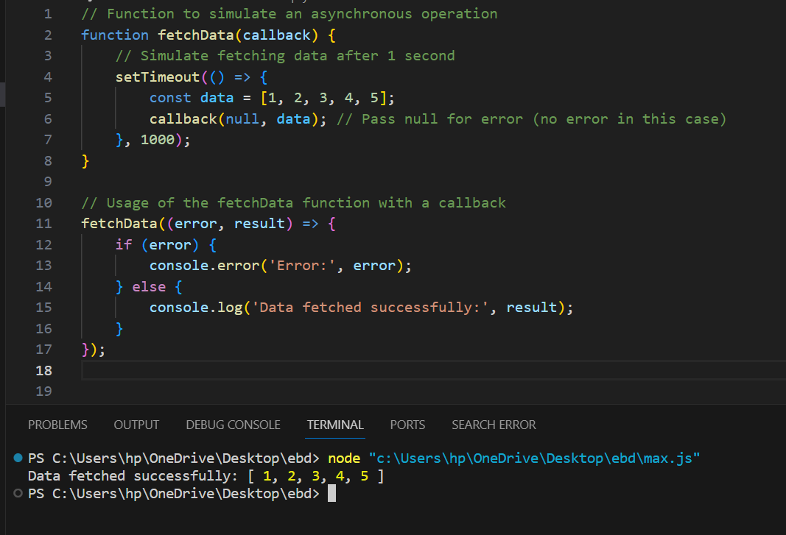
we can define a callback to print the error and result after the function execution.
function function_name(argument, function (error, result){ if(error){ console.log(error) } else { console.log(result) } })

Slide 22
In this example:
The fetchData function simulates an asynchronous operation by using setTimeout. After 1 second, it returns an array of data to the callback function.
The function is then invoked with a callback that handles the result or any potential errors.
This is a basic example, and in real-world applications, callbacks are commonly used for tasks like reading files, making HTTP requests, interacting with databases, and more.

Slide 23





Common use cases for Node.js
Real-Time Applications
API servers
Streaming Applications
Node.js is ideal for applications that need real-time interaction, such as chat platforms and online gaming.
It is commonly used to build lightweight and highly scalable APIs for web or mobile applications.
Node.js is well-suited for applications that require streaming of data and media.

Slide 24
Node.js vs other server-side technologies
Feature
Node.js
Traditional Server-side Technologies
Concurrency
Supports event-driven, non-blocking I/O
Uses multi-threading to handle concurrent requests
Performance
High performance due to single-threaded event loop
Performance may degrade under heavy load due to multi-threading
Scalability
Built-in scalability for handling large numbers of requests
May require load balancers and clustering to achieve scalability

Slide 25
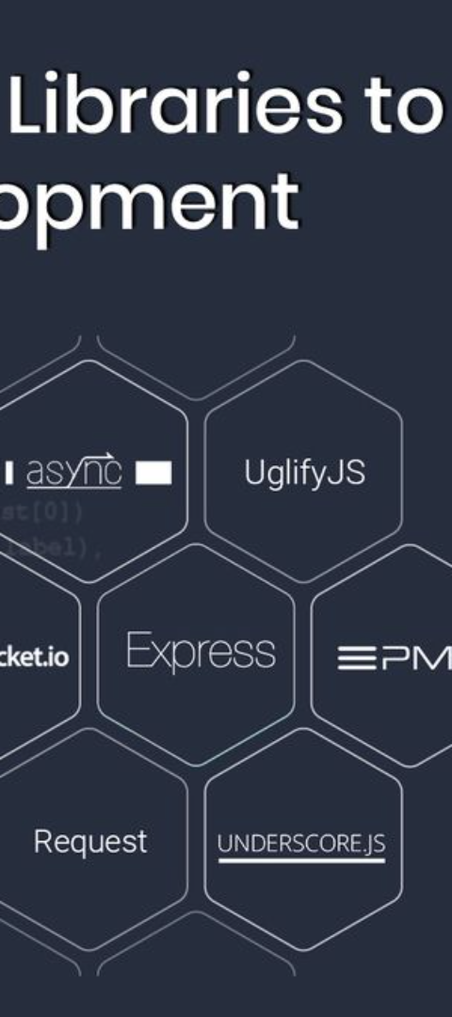
Node.js frameworks and libraries
Express.js
Sails.js
A minimal and flexible Node.js web application framework that provides a robust set of features for web and mobile applications.
An MVC web framework built on top of Express.js, designed to make it easy to build custom, enterprise-grade Node.js applications.
Socket.io
A library for real-time web applications that enables bidirectional event-based communication between web clients and servers.

Slide 26
Node.js Event Loop
Node.js is a single-threaded event-driven platform that is capable of running non-blocking, asynchronous programming. These functionalities of Node.js make it memory efficient. The event loop allows Node.js to perform non-blocking I/O operations despite the fact that JavaScript is single-threaded. It is done by assigning operations to the operating system whenever and wherever possible.
Most operating systems are multi-threaded and hence can handle multiple operations executing in the background. When one of these operations is completed, the kernel tells Node.js, and the respective callback assigned to that operation is added to the event queue which will eventually be executed. This will be explained further in detail later in this topic.

Slide 27
Features of Event Loop:
An event loop is an endless loop, which waits for tasks, executes them, and then sleeps until it receives more tasks.
The event loop executes tasks from the event queue only when the call stack is empty i.e. there is no ongoing task.
The event loop allows us to use callbacks and promises.
The event loop executes the tasks starting from the oldest first.

Slide 28
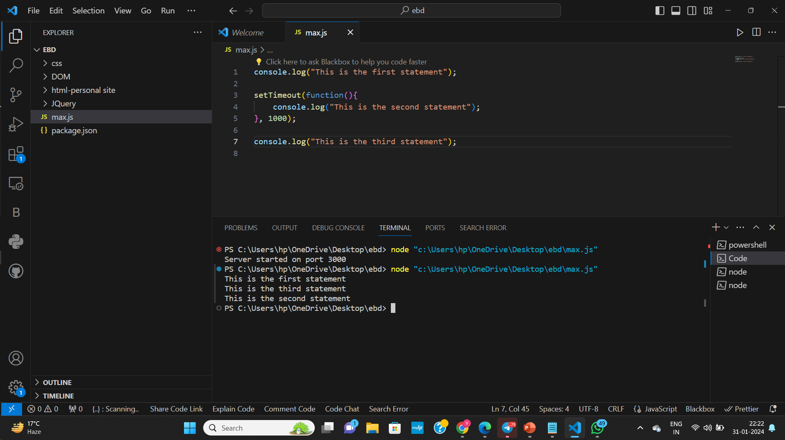
Features of Event Loop:
An event loop is an endless loop, which waits for tasks, executes them, and then sleeps until it receives more tasks.
The event loop executes tasks from the event queue only when the call stack is empty i.e. there is no ongoing task.
The event loop allows us to use callbacks and promises.
The event loop executes the tasks starting from the oldest first.

Slide 29
Explanation: In the above example, the first console log statement is pushed to the call stack, and “This is the first statement” is logged on the console, and the task is popped from the stack. Next, the setTimeout is pushed to the queue and the task is sent to the Operating system and the timer is set for the task. This task is then popped from the stack. Next, the third console log statement is pushed to the call stack, and “This is the third statement” is logged on the console and the task is popped from the stack.
When the timer set by the setTimeout function (in this case 1000 ms) runs out, the callback is sent to the event queue. The event loop on finding the call stack empty takes the task at the top of the event queue and sends it to the call stack. The callback function for the setTimeout function runs the instruction and “This is the second statement” is logged on the console and the task is popped from the stack.

Slide 30

Best practices for Node.js development
1
Code Modularization
Break your code into small, reusable modules to keep the overall application structured and maintainable.
2
Security Considerations
Implement security best practices and keep all dependencies updated to reduce vulnerabilities.
3
Performance Optimization
Optimize code and use efficient patterns to ensure your application runs smoothly and scales well.

Slide 31



Debugging and testing in Node.js
Debugging
Testing Frameworks
Mocking and Stubbing
Node.js provides built-in debugging and diagnostic tools such as the "Inspector" protocol and "Console" module.
There are a variety of testing frameworks like Mocha, Jest, and Jasmine that are commonly used for backend testing in Node.js.
Use libraries like Sinon.js to mock and stub external dependencies for effective unit testing.

Slide 32
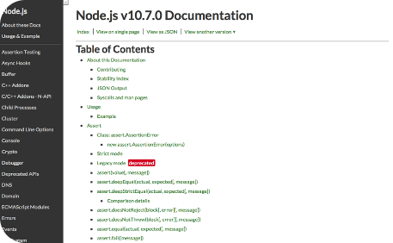
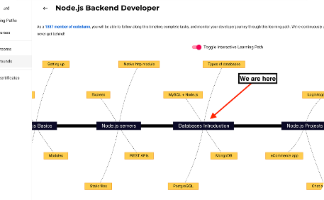
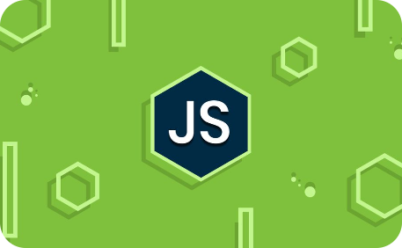
Resources and learning materials for Node.js
Official Documentation
Learning Paths and Tutorials
Online Community
The official Node.js documentation provides in-depth guides, references, and examples for all aspects of Node.js development.
Join online forums, communities, and Q&A platforms to engage with other Node.js developers, share knowledge, and seek help when needed.
Online platforms offer comprehensive tutorials and learning paths to master Node.js and its associated technologies.

Slide 33
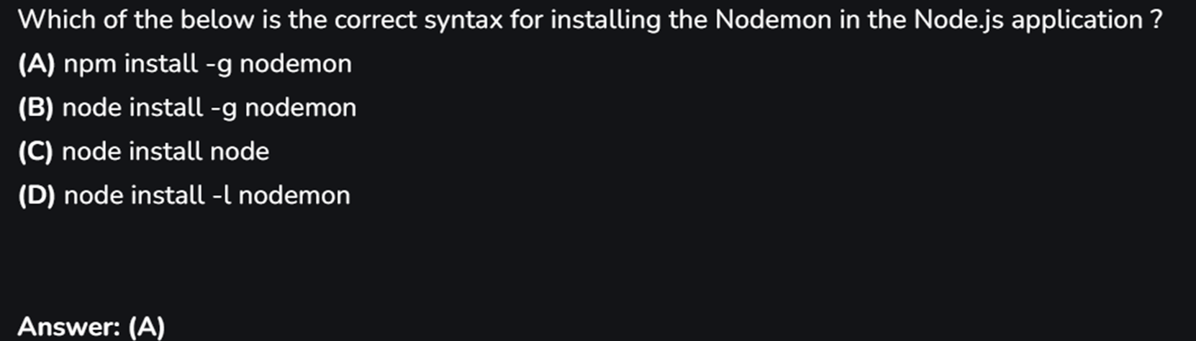
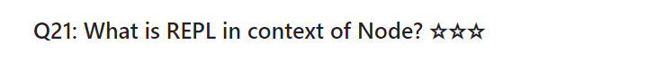
Questions

Slide 34
